Slide 1

Hik-Partner Pro
Security Business Assistant.
At Your Fingertips.

Slide 2



On-Site Installation Tool
Easy & Auto & Smart
Notes:
转场

Slide 3
Contents
Pain Points of Installation & Congratulation
The Hik-Partner Pro Solution & Key Values
    Typical Scenarios
    The SADP Design on Hik-Partner Pro
    Technological highlights
Release Plan

Slide 4





Pain Points of Installation & Congratulation
Installer needs to learn and use multiple tools
Features
Search devices in LAN | Support | Not support | Not support(Only IPC)
Activate devices | One by one / batch | One by one | One by one (Only Recorder)
Modify IP Address | One by one / batch Manual allocation | One by one Manual allocation | One by one Manual alocation
Forget password | Not Support remote reset password Reset password by email Reset password by Questions Reset password by branches | Not Support remote reset password Reset password by email Reset password by Questions Reset password by branches | Not Support remote reset password Reset password by email Reset password by Questions Reset password by branches
Modify configuration | Not support | Support | One by one
Reboot device | Not support | One by one | One by one
Restore configuration | Not support | One by one | One by one
Upgrade device | Not support | Support remote upgrade (Only recorder) Support upgrade in LAN | Not support remote upgrade Support (need USB storage)
Backup Configuration | Not support | Support(Only export to your laptop) | Not support
Auto Configuration | Not support | Not support | Support (Only recorder)
Remote maintenance | Not support | Support (IP&Port Mapping) | Not support
SADP
Device Web page
GUI
GUI on Monitor
network configuration
professional configuration
quick configuration
Notes:
在以往，安装商必须掌握3款不同的软件：SADP，设备web页面，NVR GUI。以满足不同场景的安装配置。
同时因为3款工具无法满足各个场景的功能，所以经常需要同时使用

Slide 5




Pain Points of Installation & Congratulation
Heavy & Expensive & Hard to Start
Heavy: In addition to the devices required by customers, you may also need to carry an additional monitor or laptop.
Expensive : In order to install devices, computers and monitors that need extra preparation are usually not cheap
Hard to Start: As a Hikvision Device installer, you need to master multiple tools at the same time, such as SADP, Device web configuration, and the learning cost is relatively high
GUI
Monitor
Laptop
Notes:
因为安装商需要同时使用3款工具，所以安装商必不可少的工具是电脑和显示器。
这使得安装商不仅要携带弱点安装必备工具之外，还需要额外携带贵重且笨重的显示器和电脑。
同时还需要同时掌握不同工具的使用，这极大的提高了设备的安装门槛。

Slide 6

Need a more convenient installation and configuration Tool !
Installer
Notes:
所以安装商普遍且急迫的需求是能够更简单的方便的完成设备的安装配置，更快的交付，从而提高安装效率，使得安装商提高收入

Slide 7
Contents
Pain Points of Installation & Congratulation
The Hik-Partner Pro Solution & Key Values
    Typical Scenarios
    The SADP Design on Hik-Partner Pro
    Technological highlights
Release Plan
Notes:
接下来，我将会介绍Hik-Partner Pro 的安装方案，来展示在安装商使用了Hik-Partner Pro后，安装将会是一件多么轻松愉快的事，
让我们通过一个典型场景来做开场介绍

Slide 8
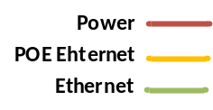
TYPICAL SCENARIO
Installation target:
All devices complete activation and basic configuration
IPC added to NVR as channels
Add to Hik-Partner Pro and enable remote management
Deliver devices to customers (Hik-Connect)
Notes:
这里，我列举了一个相对专业的场景，来讲述Hik-Partner Pro的安装配置流程。
在这个场景中，一共有1台NVR，3台交换机，以及16路POE IPC相机，组成双层网络，在上层的网络中，接入WIFI路由器。
这里我们安装商需要完成的目标是：可以将这些设备进行激活，并完成和NVR的通道关联，同时为了方便后续的远程运维，需要将设备添加到云端，同时交付给用户的Hik-Connect
OK，Let’s start the story

Slide 9

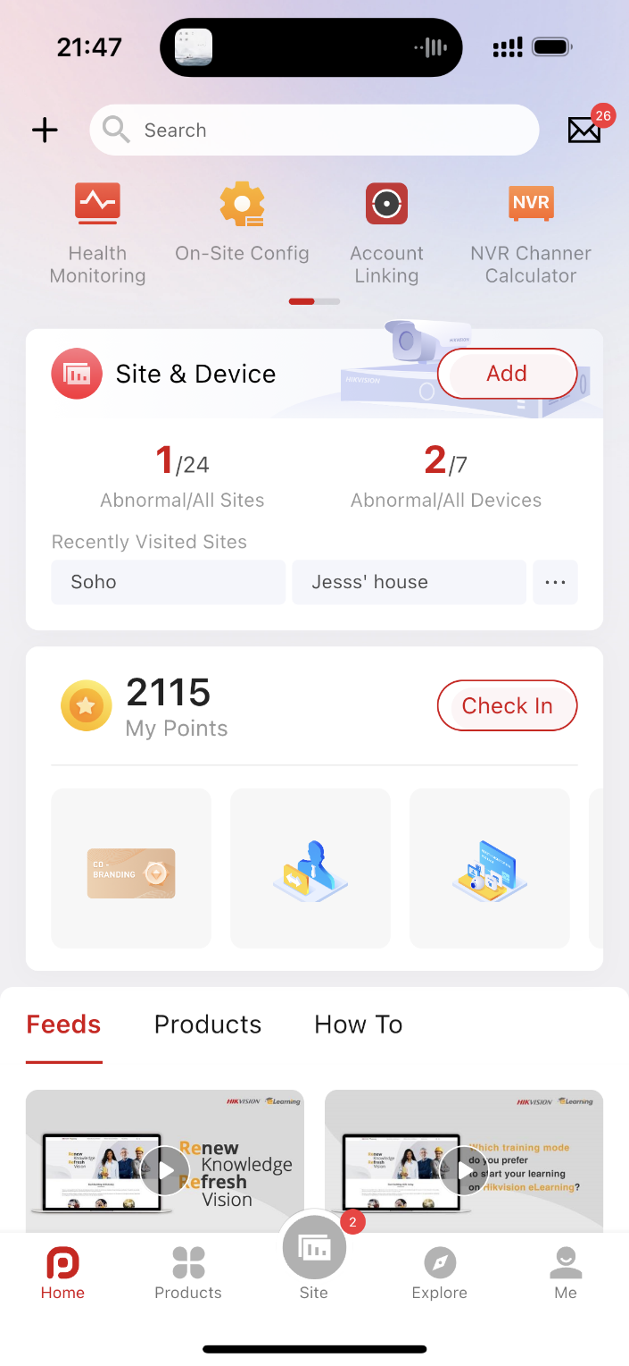
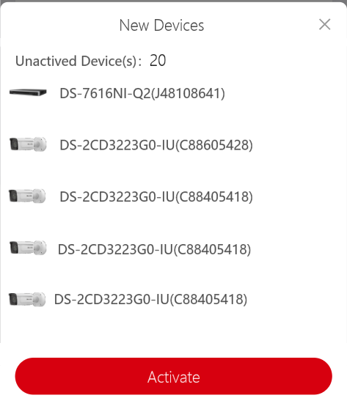

TYPICAL SCENARIO
Step 0: Prepare the Devices
Connect the NVR/Switch/IPC power supply
Connect the device network cable
Step 1: Log in Hik-Partner Pro
Link the mobile phone and WIFI* so that the device and mobile phone are in the same network
Log in Hik-Partner Pro APP
Hik-Partner Pro will automatically search for inactive devices in the network and pop up the device activation prompt
Click [Activate] for Next
WIFI*: Hik-Partner Pro supports multiple network connection modes, which will be explained in detail later
Notes:
首先在使用HPP之前，需要将所有的设备电源和网线链接好
然后将手机链接到WIFI中，使得设备和手机在相同的网络，然后打开HPP并登录。
在登录HPP之后，HPP会自动搜索到网络下新设备，并弹框提示可以进行激活安装，这非常的方便。
点击激活按钮，进入到安装配置流程

Slide 10
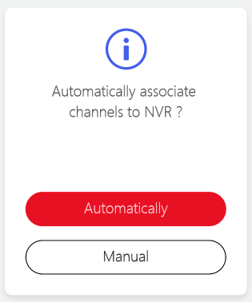
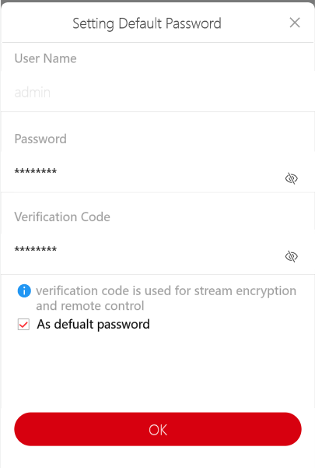
TYPICAL SCENARIO
Step 2: Confirm Activate Password
When using it for the first time, you need to manually enter the admin user password and device verification code
By checking [As default password], you can avoid repeated input in the next use
Click [OK] for Next
Step 3: Select channel link mode
Like the NVR GUI, it provides automatic channel association and manual channel association
Click [Automatically] , The inactive channel will be automatically associated with NVR
Notes:
首先HPP会先进行激活过程中必要的信息确认：
用于激活设备的admin密码和验证码，在第一次使用HPP激活设备的时候，安装商需要手动输入，通过勾选作为默认密码，HPP会将密码保存，下次激活设备的时候，不需要重复再次输入，极大减少了激活配置的繁琐输入过程。
点击【OK】完成激活密码的确认。
在这个典型场景中，我们发现存在NVR和IPC，所以我们会询问是否需要自动完成IPC和通道的关联，如果选择自动关联，则在HPP完成NVR的激活后，会自动将这些IPC关联到NVR，当然也可以点击手动关联，在设备初始化完成后，可以手动进行关联。这里我们点击自动关联，让HPP帮我们完成通道关联

Slide 11
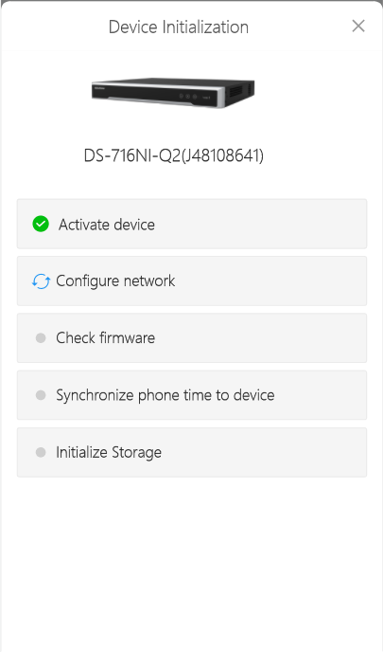
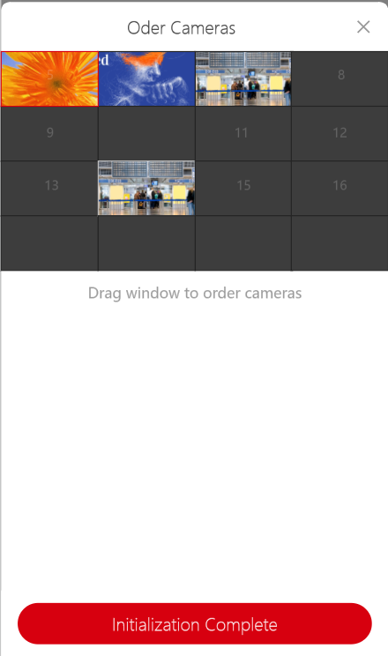
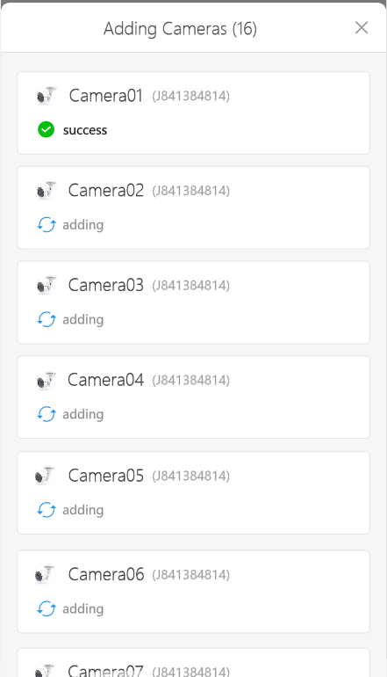





TYPICAL SCENARIO
Step 4: Automatically Initialization
Generally speaking, this process rarely needs manual processing, so step 4 will go very smoothly
Check firmware, Synchronized phone time to device and Initialize Storage are conducted at the same time
Notes:
接下来，HPP可以自动完成设备的初始化，自动并且快速

Slide 12
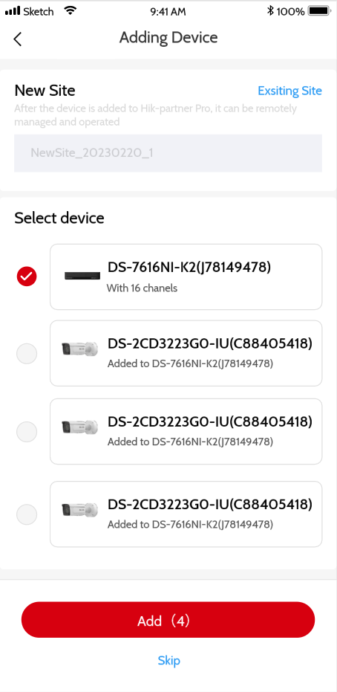

TYPICAL SCENARIO
Step 5: Add Devices to Hik-Partner Pro
After initialization, the customer will be guided to add the device to Hik-Partner Pro for remote management
NVR and Switch are selected by default
If IPC has been added to NVR, IPC will not be selected by default
Notes:
也符合安装商的习惯

Slide 13
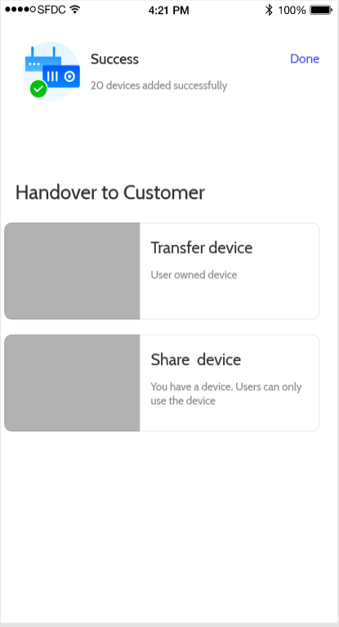
TYPICAL SCENARIO
Step 6: Handover to customer(Hik-Connect)
After adding to Hik-Partner Pro, you can choose to handover devices to customers. Hik-Partner Pro provides two handover methods
[Transfer device]:The devices belongs to the customer, and the installer needs to obtain the user's authorization to operate the devices
[Share device]:The device belongs to the installer, and the customer has only access rights. The installer can disable the customer's Hik-Connect use, similar to Hik-Connect sharing device.
Notes:
也符合安装商的习惯

Slide 14
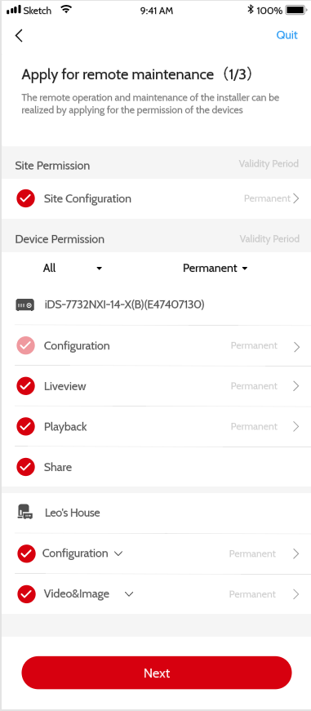
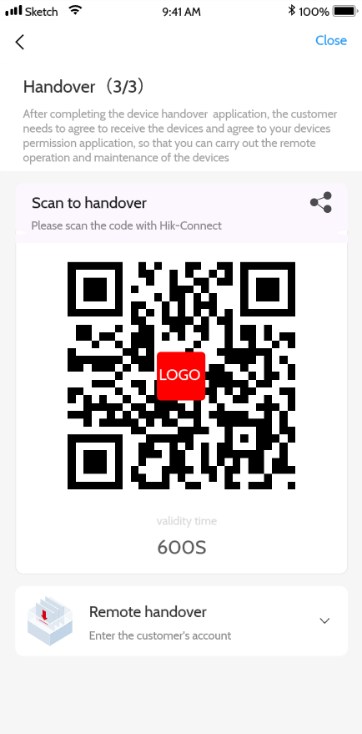
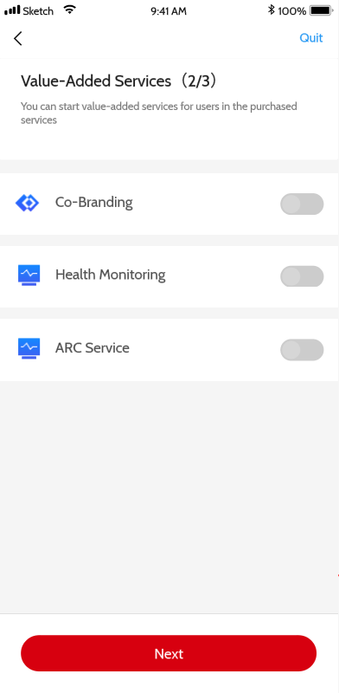
TYPICAL SCENARIO
Step 7: Handover to customer(Hik-Connect)
After adding to Hik-Partner Pro, you can choose to handover devices to customers. Hik-Partner Pro provides two handover methods
[Transfer device]:The devices belongs to the customer, and the installer needs to obtain the user's authorization to operate the devices
[Share device]:The device belongs to the installer, and the customer has only access rights. The installer can disable the customer's Hik-Connect use, similar to Hik-Connect sharing device.
Notes:
也符合安装商的习惯

Slide 15

7
Easy
Auto
Smart
Just carry your mobile phone
Don't need to know too profound network knowledge
Simple addition and handover
Auto discover inactive devices and pop-up to start
Automatically complete activation and initialization configuration
Smart entry initialization boot according to the active device type
steps for all

Slide 16
Contents
Pain Points of Installation & Congratulation
The Hik-Partner Pro Solution & Key Values
    Typical Scenarios
    The SADP Design on Hik-Partner Pro
    Technological highlights
Release Plan

Slide 17

The Hik-Partner Pro Mobile Solution on Installation & Configuration
SADP + device web + GUI can be replaced by Hik-Partner Pro
Features
Search devices in LAN | Support | Support | Not support | Not support
Activate devices | One by one / batch | One by one / batch | One by one | One by one (Only Recorder)
Modify IP Address | One by one / batch Automatic allocation | One by one / batch Manual allocation | One by one Manual allocation | One by one Manual allocation
Forget password | support remote reset password* Reset password by email Reset password by Questions Reset password by branches | Not Support remote reset password Reset password by email Reset password by Questions Reset password by branches | Not Support remote reset password Reset password by email Reset password by Questions Reset password by branches | Not Support remote reset password Reset password by email Reset password by Questions Reset password by branches
Modify configuration | Support | Not support | Support | One by one
Reboot device | One by one / batch | Not support | One by one | One by one
Restore configuration | Support | Not support | One by one | One by one
Upgrade device | Support remote upgrade Support upgrade in LAN | Not support | Support remote upgrade (Only recorder) Support upgrade in LAN | Not support remote upgrade Support (need USB storage)
Backup Configuration | Support backup on cloud | Not support | Support(Only export to your laptop) | Not support
Auto Configuration | Support (Only recorder) | Not support | Not support | Support (Only recorder)
Remote maintenance | Support (P2P tech) | Not support | Support (IP&Port Mapping) | Not support
Hik-Partner Pro
SADP
Device Web page
GUI
GUI on Monitor
All in One
network configuration
professional configuration
quick configuration
support remote reset password*：Device needs to be delivered to Hik Connect through Hik Partner Pro via P2P
Notes:
对内的对比

Slide 18
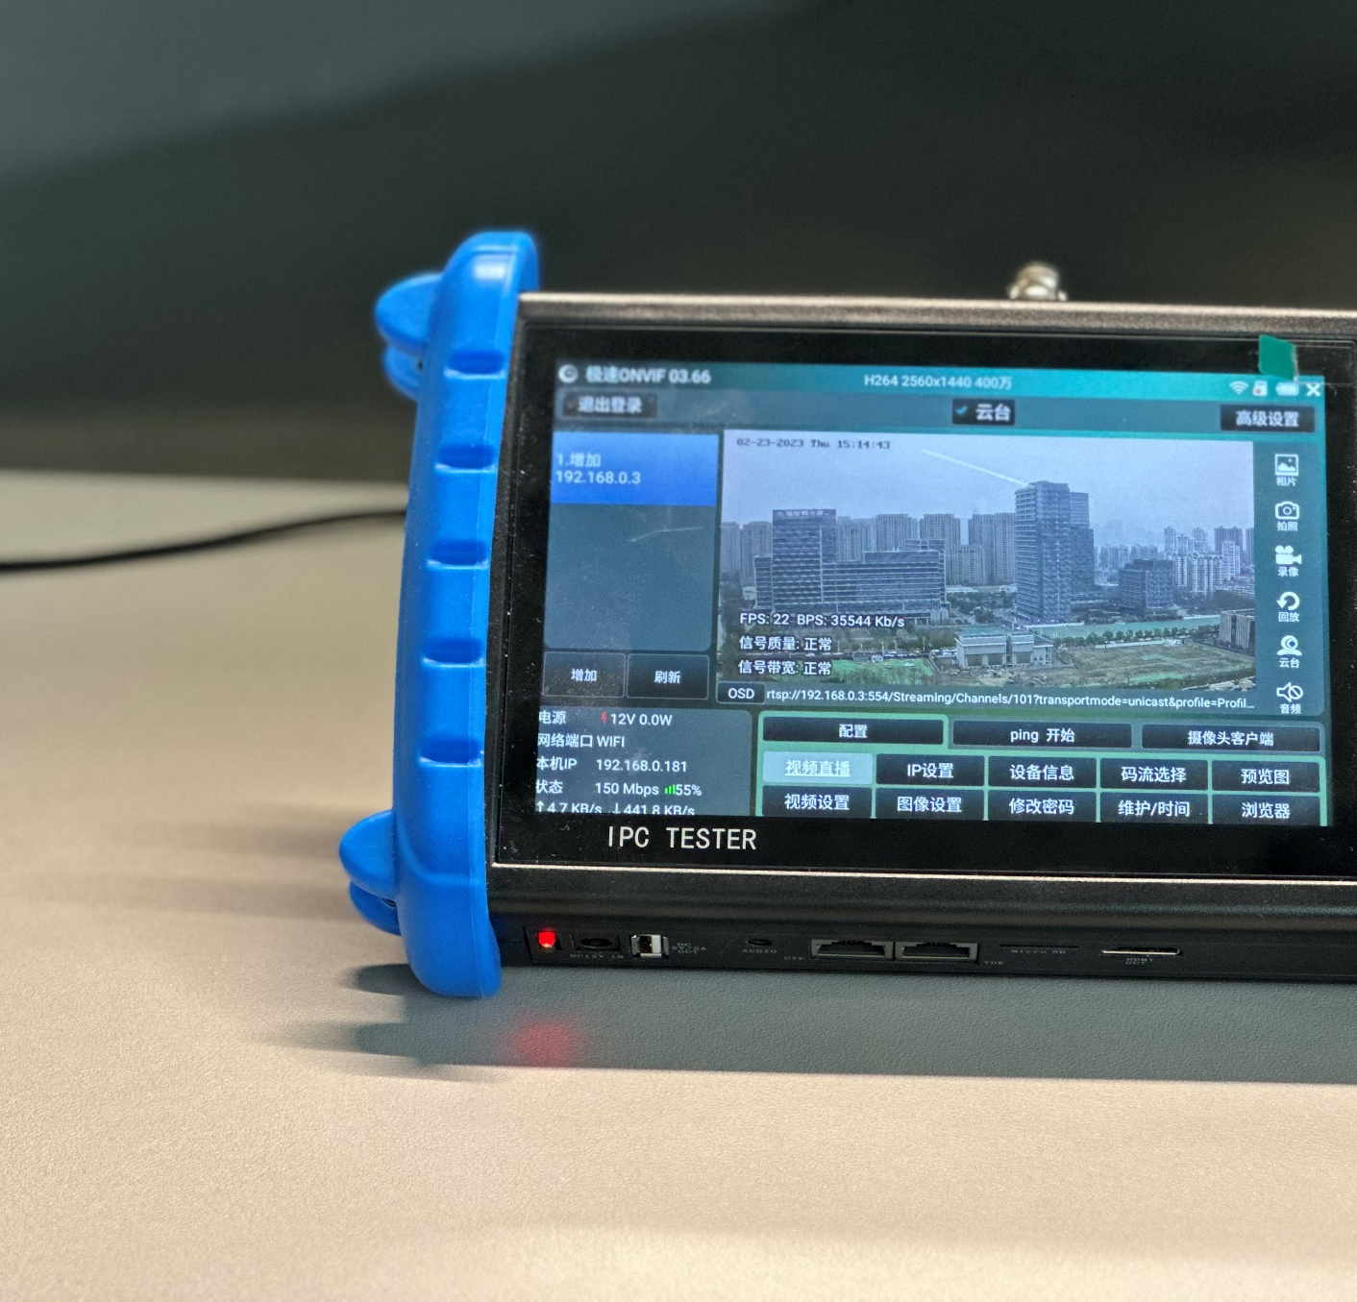
  Advantages of professional installation tools
  Preview and configure the same screen operation
  Highlight common configuration entries
Notes:
对外的

Slide 19

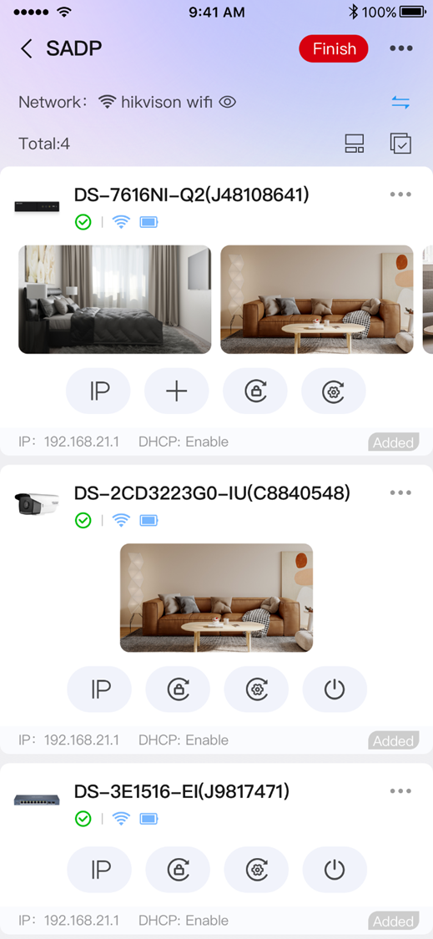
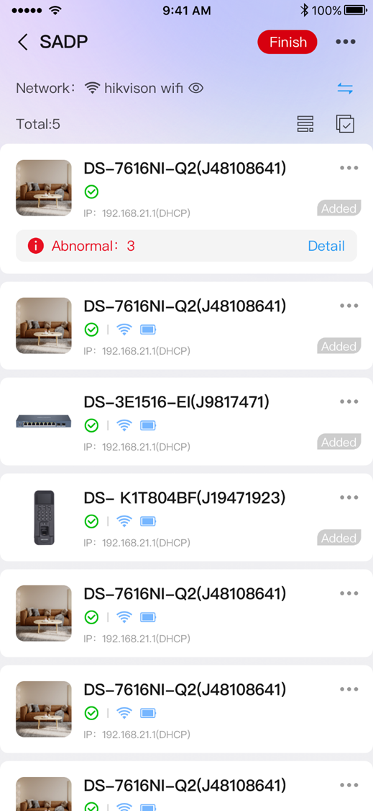

  The SADP Design on Hik-Partner Pro
Security Business Assistant. At Your Fingertips.

Slide 20
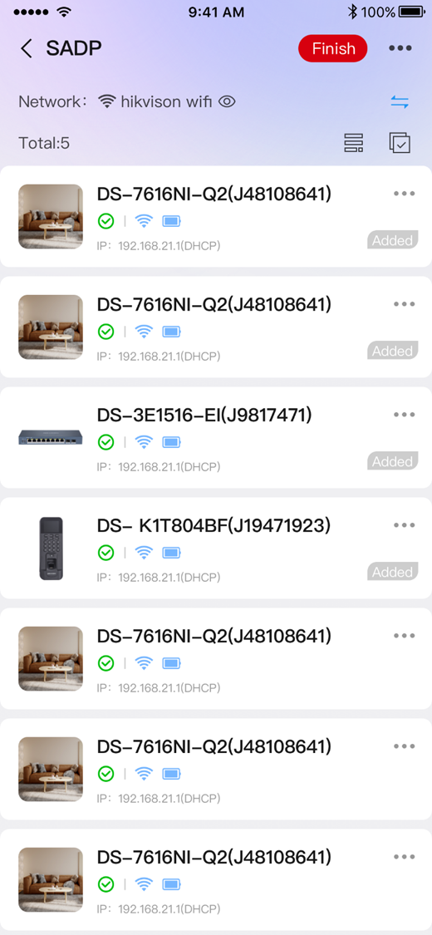
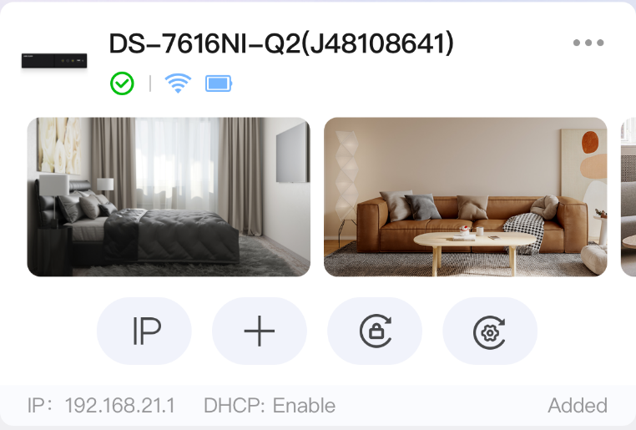
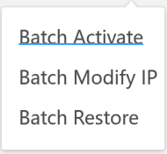

Device Card – Easy to quick operation
  Display channels of NVR
  Display quick operation
Device List – Easy to find device
  Display more devices
Notes:
便捷
保留

Slide 21
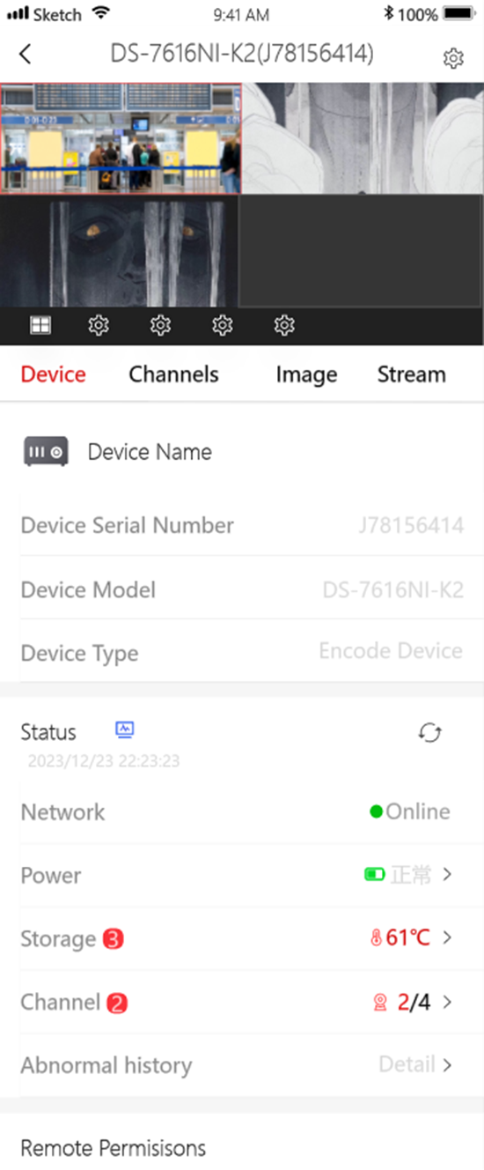
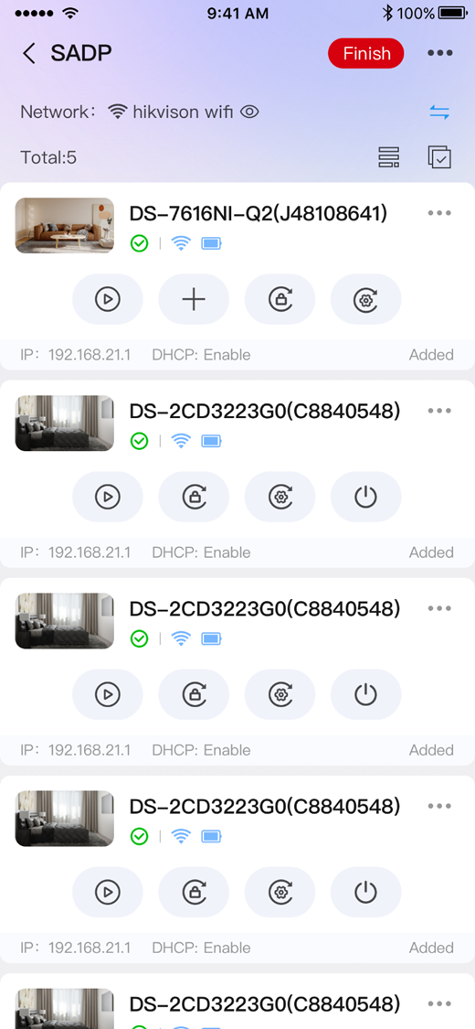
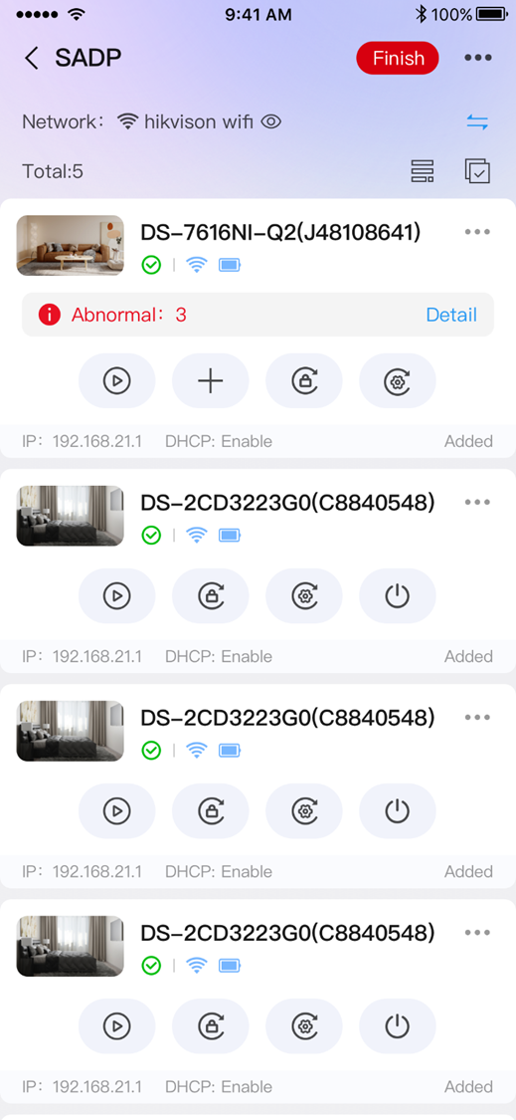
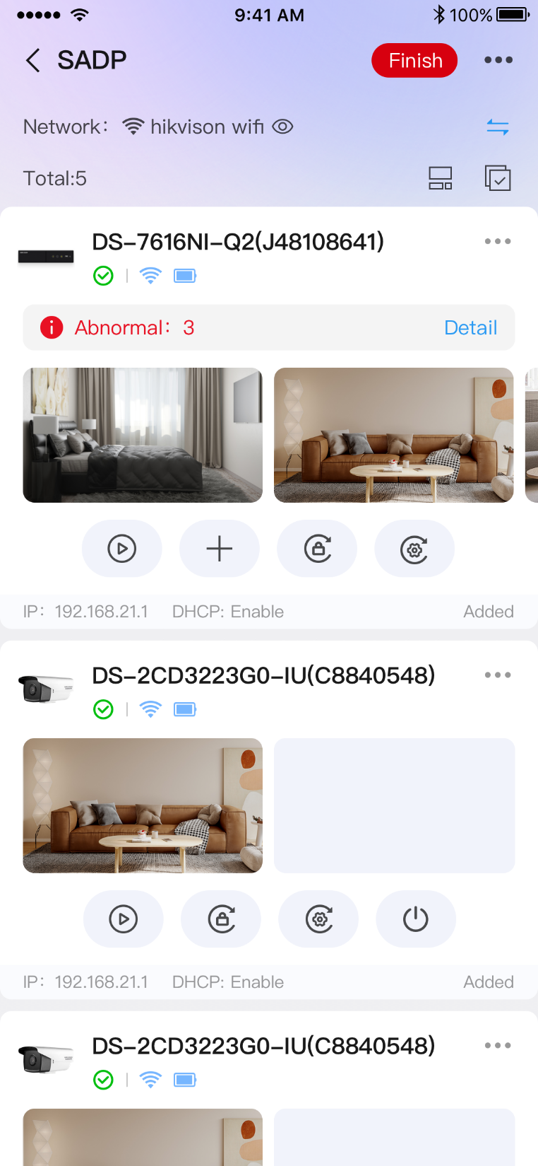

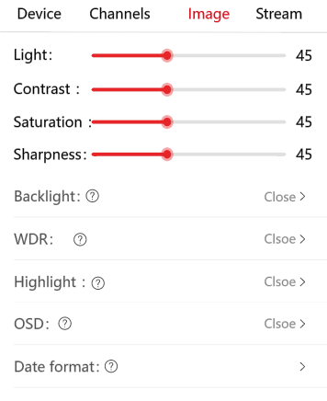
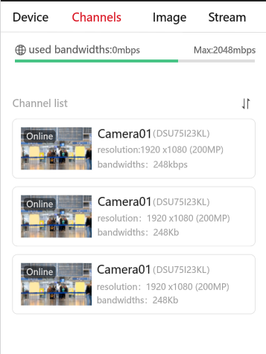
Easy to find & fix abnormal of device
  Display the number of device exceptions
  Provide automatic exception repair and troubleshooting guidance
Easy to configure CCTV device
  Liveview and configure on the same screen
  Quick configuration of common parameters
Notes:
保留，异常也放进来。点击画面，进入同屏配置

Slide 22
Contents
Pain Points of Installation & Congratulation
The Hik-Partner Pro Solution & Key Values
    Typical Scenarios
    The SADP Design on Hik-Partner Pro
    Technological highlights
Release Plan
Notes:
说明

Slide 23



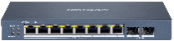

The Hik-Partner Pro Mobile Solution on Installation & Configuration
A solution for customers' WIFI not having access to the Internet
Hik-Partner Pro
SMART
Mode
Internet
Cloud Communication
Login Hik-Partner Pro
Check / download the latest firmware of devices from cloud
Backup configuration of devices
Submit support case
cellular
CCTV LAN
Devices Communication
OR
Activate devices
Get status of devices
Configure devices
Upgrade devices with downloaded firmware
The m mode is automatically completed by the Hik-Partner Pro APP without additional operation
SMART

Slide 24



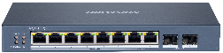

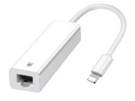
The Hik-Partner Pro Mobile Solution on Installation & Configuration
The installer quickly adjusts the IPC installation angle or configuration
POE repeater
Long distance
OR
With POE repeater, you can expand a LAN port to access the network.
If all the switch LAN ports have been used, you can also use the POE repeater to extend a LAN port.

Slide 25


The Hik-Partner Pro Mobile Solution on Installation & Configuration
A solution for customers' Network doesn’t have WIFI
Network Extend （AP）
Type-C / lighting to LAN Cable
Change the Network Extend to AP mode (only needs to be configured once)
Connect network extend to switch with Ethernet cable
Mobile phone connect to network extend via WIFI
Connect type-C / lighting to LAN Cable to POE switch
Connect type-C / lighting to LAN Cable to smart phone
If there is no router(DHCP) in the network, you need to manually configure the mobile IP address

Slide 26

The Hik-Partner Pro Mobile Solution on Installation & Configuration
Wide compatibility for to LAN Cable
 | Cellular | Ethernet | WIFI | SMART Mode | Conclusion
 | √ | √ |  | Not Support | Due to the limitation of iOS system, under iOS system, Ethernet Cable is used, and Smart mode cannot be supported
 | √ |  | √ | Support
 | √ | √ | √ | Not Support
 | √ | √ |  | Support
 | √ |  | √ | Support | Android system above 5.0 can perfectly support SMART Mode
 | √ |  |  | Support
 | √ | √ | √ | Support

Slide 27
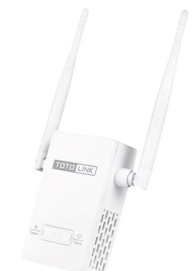
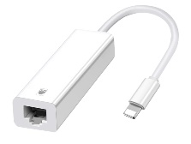
Hik-Partner Pro Solution
Lite & Economy
VS
Traditional Solution
Heavy & Expensive
One APP
Multiple software
Optional
GUI
POE repeater
Network Extend
（AP）
Type-C to LAN
Cable
Monitor
Laptop
Smart Phone
Notes:
最后的一个总结页
去掉价格

Slide 28
Contents
Pain Points of Installation & Congratulation
The Hik-Partner Pro Solution & Key Values
    Typical Scenarios
    The SADP Design on Hik-Partner Pro
    Technological highlights
Release Plan
Notes:
说明

Slide 29
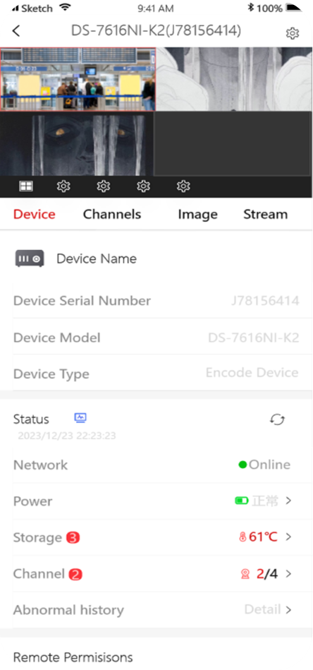
Release PLAN
2023.5
2023.6
7 step for all
NVR/DVR auto initialization
SADP Tool
Smart mode
Batch configuration
Reset device password
New designed CCTV device configuration
Backup Configuration on cloud
More batch configuration

Slide 30



