Slide 1

Notes:
Opening
Making pro, more pro. Ladies and gentlemen! Welcome to the launch of Hikvision EasyIP 4.0 plus!
I am Dean Edwards from Hikvision.
I'm thrilled to have you here today to experience something new together.

Slide 2



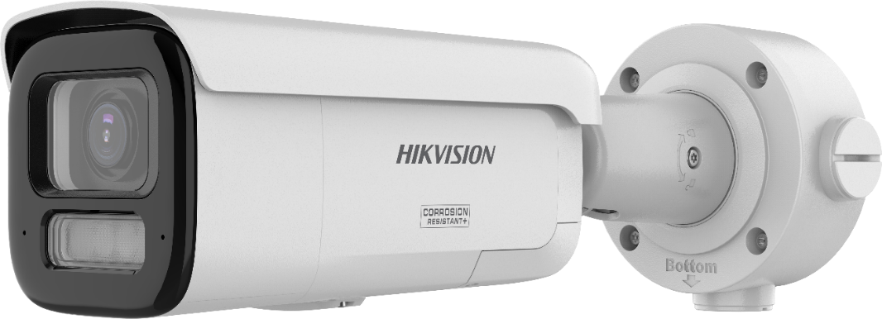
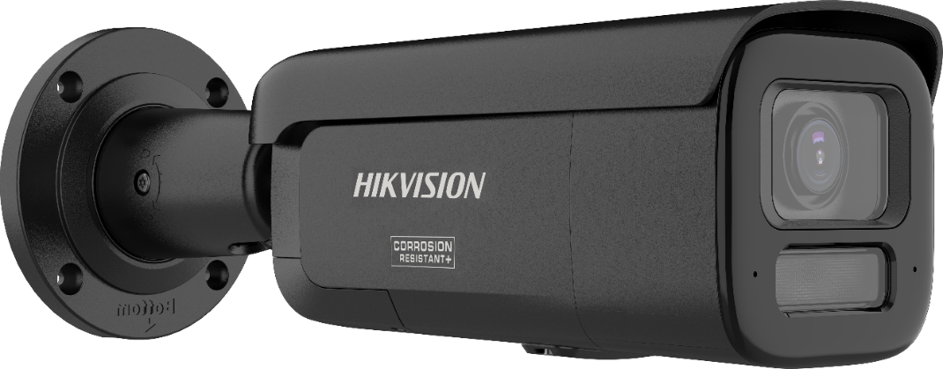






PRODUCT FAMILY
Notes:
产品经理发言

Slide 3

In addition to the four major technology innovations,
What other features have been upgraded in the 2xx7G3?

Slide 4
The entire series supports anti-corrosion feature.
What are the recommended scenarios for this feature?

Slide 5
What is the product release date?

Slide 6

Looking forward to more creative products of EasyIP 4.0 Plus

